Slide 1
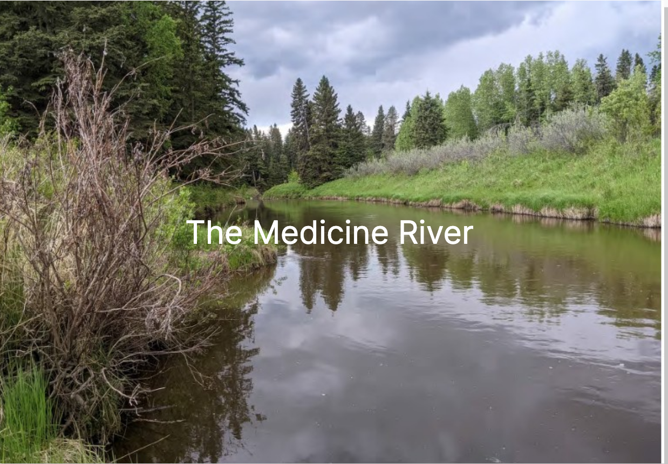
Watershed Society
Presentation of concern for the
Medicine River and Paskapoo Aquifer
March 16, 2026
Notes:
cover page of the Medicine River photo
Title: Medicine River watershed and Paskapoo aquifer presentation

Slide 2
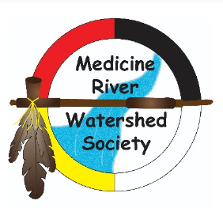
Discussion “AGENDA”
Membership
Presentation priorities
  State of the River and Aquifer
  Data collection
  Coordinating with Drought Cycles
Summary and future solutions
Notes:
Our discussion today wants to provide a brief overview of the Paskapoo aquifer and the Medicine River Watershed.
We want to highlight some things we know about these freshwater sources and the data collection desired to create a complete picture.
The region is in the highest drought ranking and this forces us to consider how we may need to balance uses to match drought cycles.
Additionally, the current and increasing freshwater use highlight the need for recycled water use and what solutions are available.

Slide 3
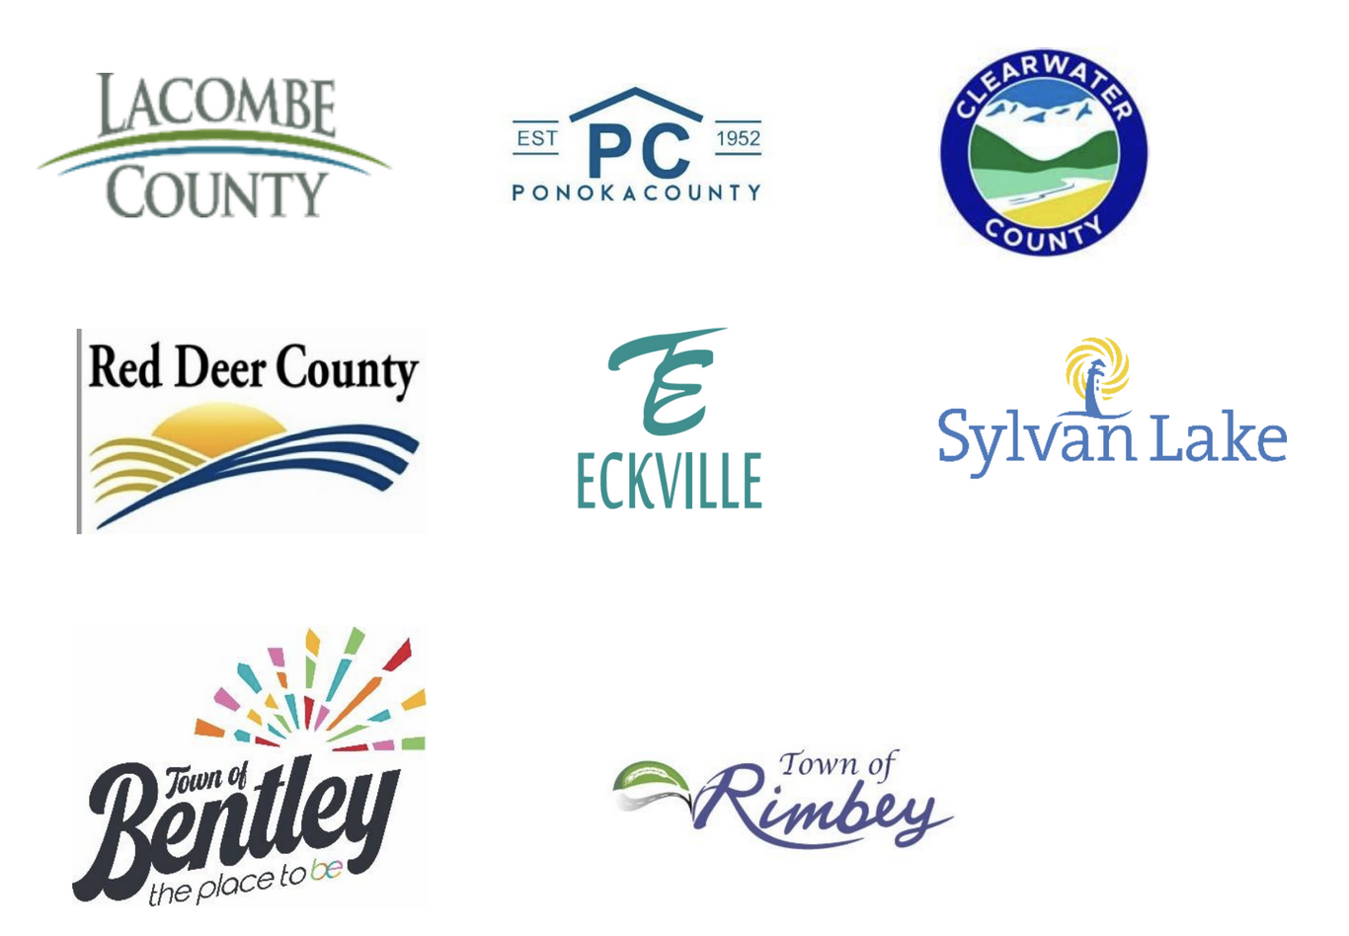
Society Composition
Formal representation on the board from
7 municipalities:
Town of Sylvan Lake, Town of Eckville, Town of Bentley, Clearwater County, Red Deer County, Lacombe County, and Ponoka county.
Other board members: farmers, aquaculturists, and interested citizens.
Collectively, our board represents 77,000 people.
Notes:
MRWS has member representation on the board from 7 municipalities, including the town of Sylvan lake, the town of Eckville, the town of Bentley as well as Clearwater County, Red Deer County, Lacombe, County, and Ponoka county.
The Town of Rimbey supports our board and is soon considering providing an elected official to join our board.

Slide 4
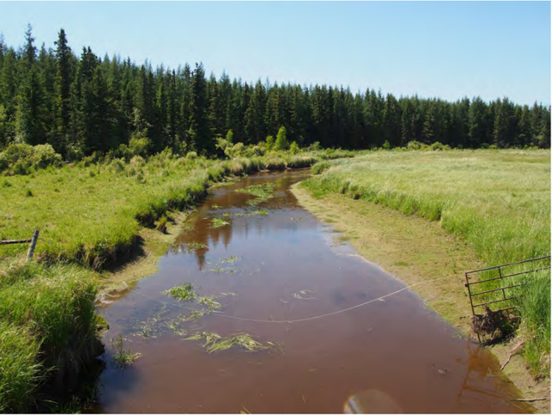
80 km long as the crow flies but 400 km long by canoe
Gradient of .00019
Travel over 400’ to drop an inch
The river is best defined as lentic; standing water
In reality, it is a long skinny lake with almost no flow
Notes:
The Medicine River is 80 km long as the crow flies but meanders for around 400 km if you travel it by Canoe
It has a gradient of .00019 which is almost flat.
The river is best defined as Lentic, or “standing water”.
In reality, it is a long skinny lake with almost no flow

Slide 5
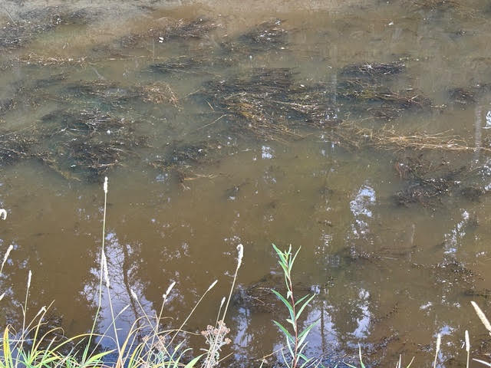
The real state of the river
The 8th dirtiest river in Canada based on data that the watershed society collected in 2006 and 2007
- rating “Poor”
2009 Red Deer River Watershed Alliance “State of the Watershed Report”
- rating “Poor”
From 2007 to 2022, no data collected by the Society
Notes:
some background about the Medicine River
> -it has a stigma of being the eighth dirtiest river in Canada based on data that the watershed society collected from River sampling in 2006 and 2007. It got a rating of “poor”
> The 2009 Red Deer River Watershed Alliance ‘state of the watershed’ report also provided a rating of poor
> From 2007 to 2022 there was no data collected from the Medicine River watershed Society (MRWS)

Slide 6
Aquifer COnnection - to the river and People
Medicine River occupies a local sandy aquifer in its valley which connects to Paskapoo bedrock.
Position at the top of the water cycle means no inflow of water from other bedrock aquifers.
River water is sourced within the watershed making it drought sensitive.
David Toop
Notes:
The Medicine River flow and level is very sensitive to drought patterns and water use from it.
The river does not have multiple aquifers to replenish it and it like lakes in the area are dependent on good precipitation.
Snow melt and spring rains are critical to flushing it clean and these conditions haven’t existed for years.

Slide 7
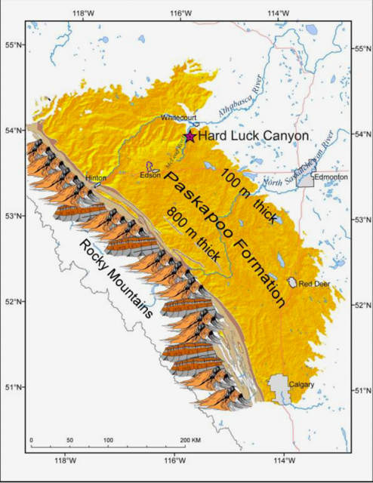
PAskapoo Aquifer
The Paskapoo aquifer stretches from Fox Creek to south of Calgary.
Much of western Alberta is interconnected through our wells and surface features.
IE. Sylvan Lake is 10% aquifer/spring fed. The Town relies 100% on the aquifer for freshwater.
IE. The Medicine River and surrounding wells act as barometer of Paskapoo health.
Notes:
There is some knowledge of how the aquifer and the Medicine River interact, as well as the neighbouring watersheds of Sylvan Lake and Blindman River.
Each well and waterway in the region has connections to shallow or deeper parts of the aquifer and can act as a barometer. The data collected on lake levels, and well behaviour can give us a better picture of freshwater capacities in the region.

Slide 8
the river and Aquifer Data - an unclear image
Sampling restarted in 2023 in partnership with the RDRWA and Creek Watch.
Measured parameters: temperature, turbidity, dissolved oxygen, phosphorus, ammonia, nitrogen, pH, chloride.
It appeared that there were some improvements to the river in 2023, but in 2024 Red Deer River Watershed Alliance analyzed low dissolved oxygen levels and higher river temperature.
2025 data analysis in progress. With continued drought and increased water withdrawal, no improvement is expected.
Notes:
In 2023 our watershed society started sampling again by partnering with the RDRWA and Creek Watch, an Albertan citizen scientist program.
The parameters sampled were temperature, turbidity, dissolved, oxygen, phosphorus, ammonia, nitrogen, pH, chloride
It appeared that there were some improvements to the river in 2023, but in 2024 the Red Deer River water, shadow alliance provided in their report that dissolved, oxygen levels were low, and the temperature of the river had gotten high.
We are still waiting for RDRWA to finalize the results from our 2025 sampling but as there was continued drought and an increase in water withdrawal in 2025, we are not expecting improvement since the river is flushing itself even less.

Slide 9
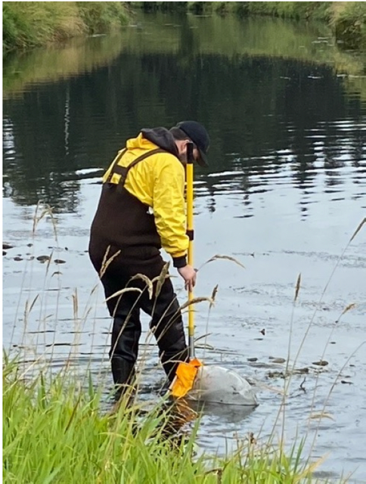
Is our data clear?
Some data we have can support an accurate picture of river health.
We also have data that likely misleads industry. Specifically the assumptions to measure and calculate waterflow are not as valid when current approaches zero or in the presence of a beaver dam.
Our water use decisions are based on this possibly inaccurate methodology.
Notes:
we have an incomplete picture of the river and the aquifer that feeds it.
> We are in year 10 of a drought cycle and are in year three of increased industrial use for fracking operations. Thus we are seeking a balanced approach in water use permitting that follows the drought cycle and includes stronger oversight.
> The measurement of the river flow methodology needs review. The water level accuracy that is currently used is questionable when we see the river is low .
> The Medicine River is currently under a water short advisory. So there is concern that TDL‘s are still being approved until there is further accurate study.

Slide 10
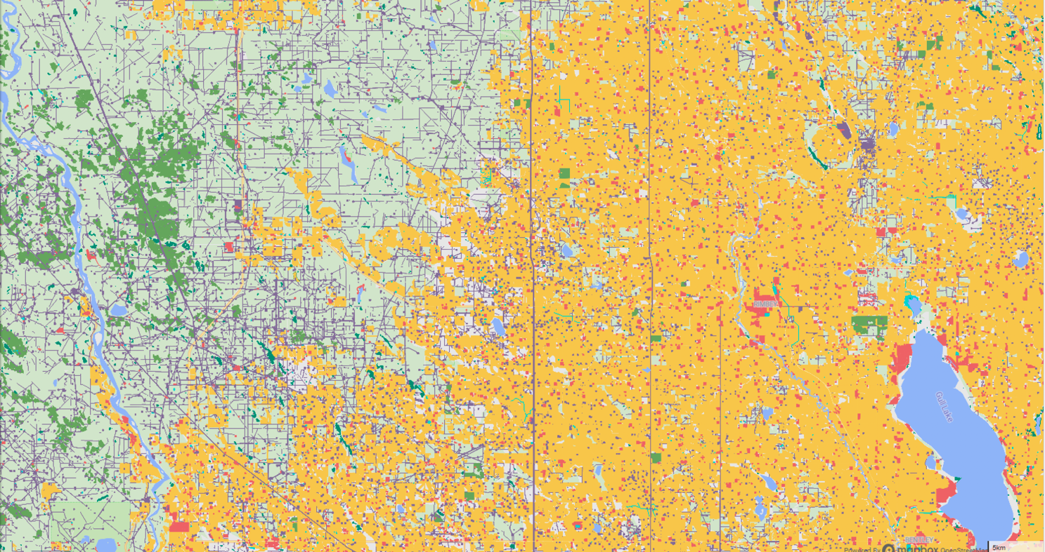
Finding the balanced approach with our drought cycles
Notes:
This map shows how actively we use our landscape. Green is forestry, yellow is agriculture, red is for the combination of urban, rural and general industrial use; and lastly purple dots and lines are oil and gas.
Each colour on this map represents a human activity that affects freshwater. Some of the colours represent high impact use such as certain energy techniques and urban settings. Other uses, such as forestry consume little, but still have risk affects to water quality.

Slide 11
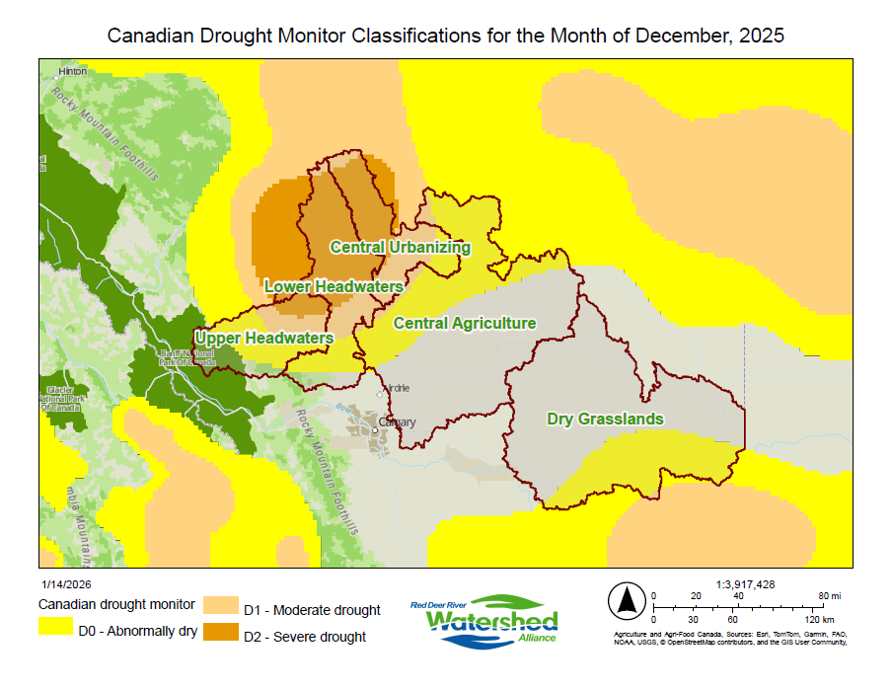
Drought status today
The Medicine River exists and all members of the society live in the most severe drought zone
Notes:
This map shows a red star which is the approximate location of Eckville and the midpoint of the Medicine River.
The dark green zone are the National Parks of the Rockies. Hinton is in the top left corner and Fort McLeod is near the bottom of the map
In the darkest brown is the severe drought zone, where there is little to no water found in sloughs.
Several farmers are reporting that water wells are going dry in the Gilby, Eckville and Markerville areas. There are probably other dry wells unreported, as the reports received were not canvassed. The dry well information was all self reported.
Failed agricultural wells are being reported in a large region in and outside of the Medicine River Watershed. We have 18 reports of failed wells and we are aware that Town of Sylvan Lake has seen stressed conditions in wells in the last few years during high demand times. Town infrastructure repairs were done, they are building extra infrastructure to supply water across their current neighbourhoods. Town of Sylvan Lake is also licensed to connect three more wells and is actively pursuing several more new wells and re-licensing of an existing well.

Slide 12
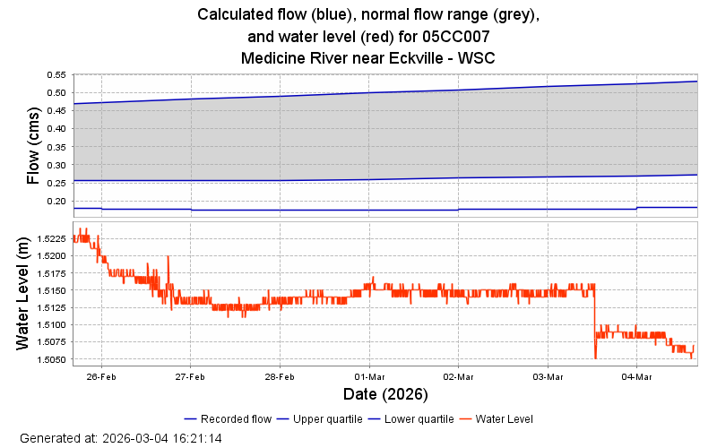
The flow of the Medicine River
Notes:
This graph shows the flow rate of the Medicine River.
The lowest blue line shows flow is at about 0.18
The normal flow should be in the grey zone which averages double the flow measured in the last month (Feb-March 2026)

Slide 13
The depth of the Medicine River
Notes:
This graph shows the water level (depth of the river) continues to drop two centimeters in the last month. (Feb -March 2026)
Lower winter levels are expected but less precipitation for last 11 years does not replenish and provide for a natural flushing of the river in the spring to summer months.
These depths are below historical averages.

Slide 14
Solutions and progress possibilities
Working together on data collection to create an understanding of the Medicine River watershed and Paskapoo aquifer with all its interconnections to our communities and uses.
Tracking drought cycles to balance use by all communities and industries.
Promote best practices and regulations for agriculture, energy, and urban centers to raise health of Medicine River.
This includes: Industrial/producer water, agriculture
and urban water use and release.
Notes:
The Medicine River watershed Society is a volunteer group doing this work with very few funds. We are seeking to partner with the province’s relevant ministries and the AER to help with data collection, etc., to gain an understanding of the sustainability of the Medicine River and it’s related Paskapoo aquifer.
In recent years the society has become very active and funding is one of the few limiting factors to increasing our community science support work.
With a few financial supports from Energy companies, municipalities and private donations, we have been able to re energize our work, but this work needs to expand to help industry and community understand the Paskapoo and surface water conditions, and interconnectedness through the aquifer.
Any partnership with Alberta government ministries and sources of funding could support several watershed groups that are interconnected by proximity and a common flow into the Red Deer river.
The increase in understanding the Red Deer River and its tributaries will also help with future dam development, agriculture management hundreds of kilometers downstream, freshwater treatment at Henday and Red Deer City facilities. Better understanding of the freshwater systems will support the natural state of all the interconnected rivers and support understanding the most recent energy industry water uses fit into this complex interconnected Paskapoo aquifer and waterways.

Slide 15
Alternative Water Sources
Agriculture , urban centers and energy sector can all be part of the wise use of water.
No one is breaking “the law”.
Clear regulations guide each user.
Yet, each user is still putting others and the natural environment at risk.
As industries and users change technologies, regulations can evolve to protect freshwater.
Notes:
The users of the Medicine and the Paskapoo aquifer include municipalities, energy sector, and agriculture.
All groups appear to be conforming to regulations properly. However, regulations likely need to be altered so that the natural environment is protected as well as the sustainability of each user.
To balance the water of the Paskapoo, and Medicine River and all others in the region, it is likely that regulations will be adjusted over time. The MRWS wants to support clear regulatory decisions today and wise regulatory changes where necessary into the future.
As an example of future possibilities that can affect most notably the energy sector and fracking water use, we want to share water filtering solutions in this presentation as well. Industrial water filtering companies target oil and gas as a growth industry. But we know that the water filtering systems can be used by agriculture and municipalities as well.

Slide 16
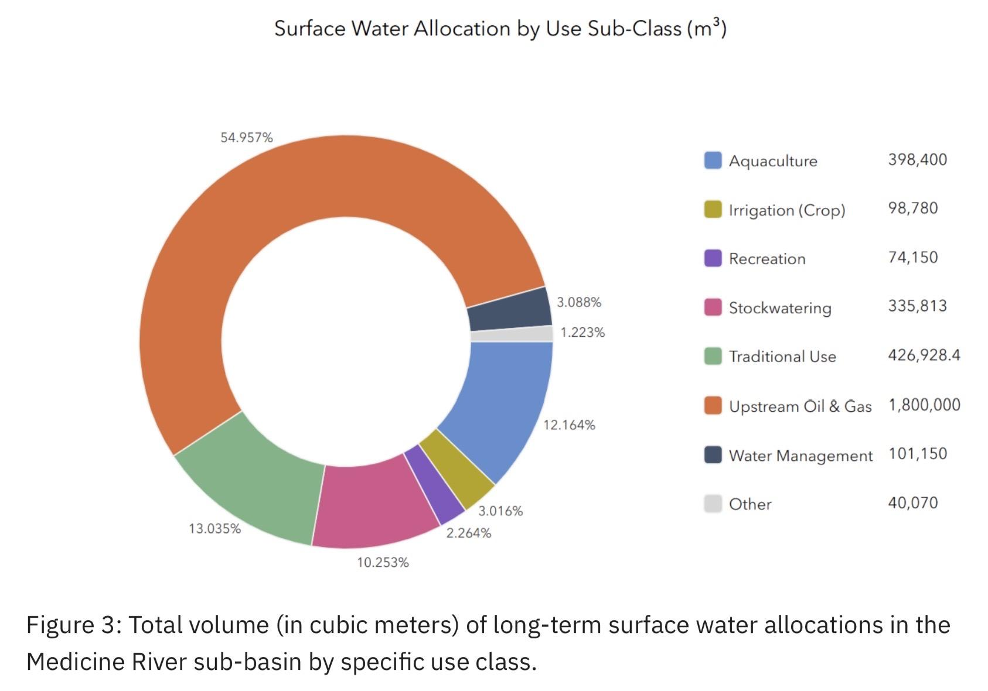
Long term freshwater licenses - Medicine River
Notes:
This graphic shows that the energy sector has licenses for 55% of the freshwater allocated from the Medicine River on a long term basis.
These Oil and Gas licenses amount to 1.8 million cubic meters of water.
The next slide will show the temporary licenses issued beyond these amounts.

Slide 17
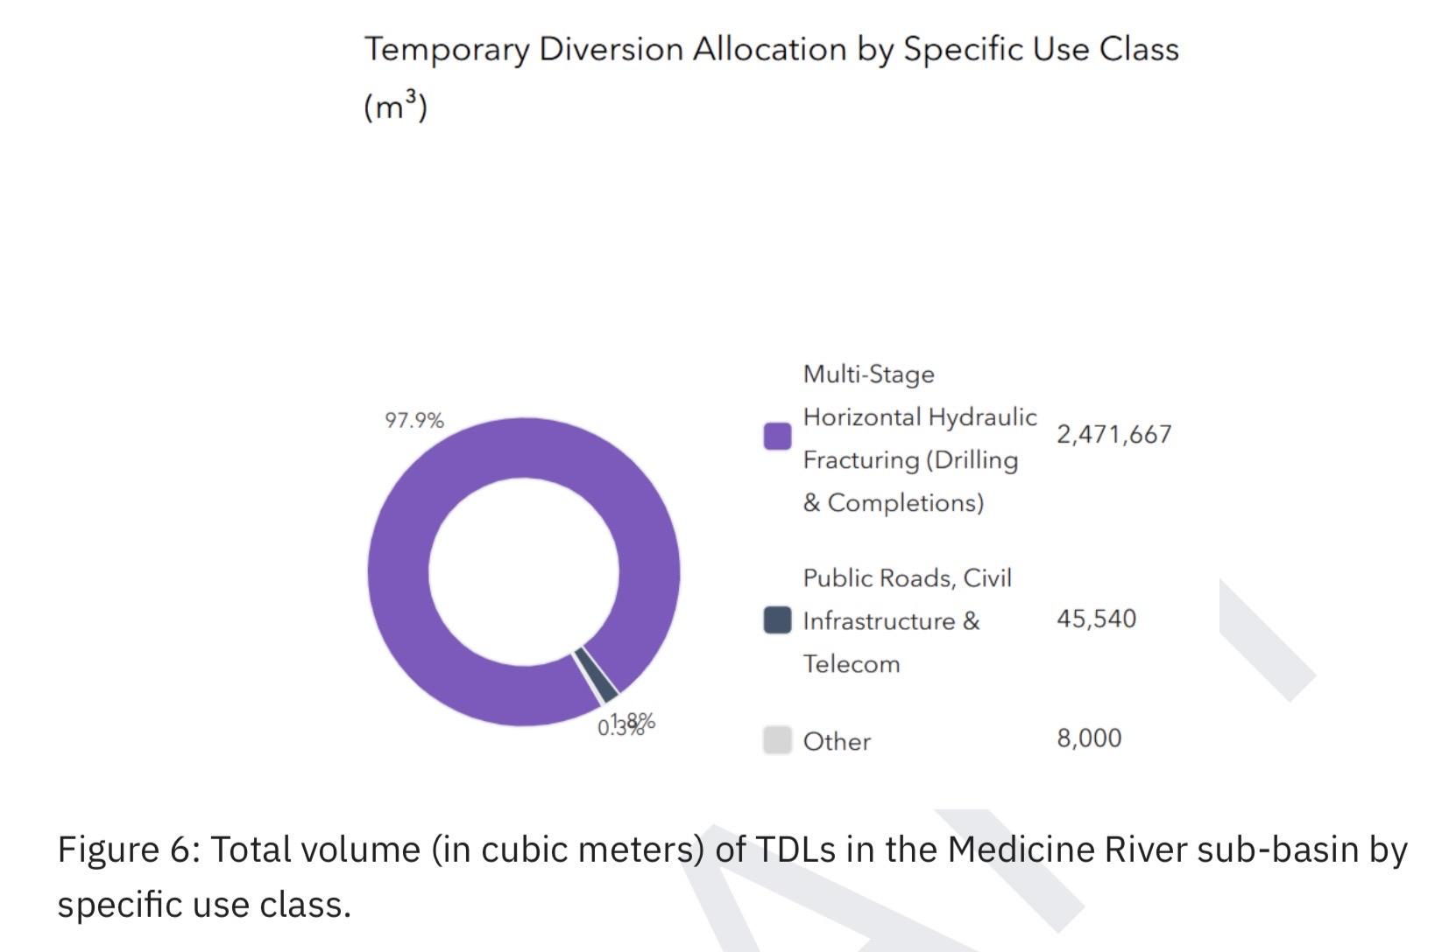
Temporary license freshwater use - Medicine R.
Notes:
This graphic is for temporary diversion licenses issued from the Medicine River.
The energy sector holds 98% of the temporary licenses and it amounts to 2.5 million cubic meters.
Together, the two types of licenses for the energy industry amount to 4.3 million cubic meters, or 4.3 billion liters of water.
This amount of water can fill 1.9 thousand Olympic size swimming pools.

Slide 18
Illustrative example: Aqua Pure Technologies
MRWS does not endorse any one company
Aqua Pure Techn. can filter industrial waters and has been funded by the Gov’t of Alberta. They are a potential solution to freshwater use as stated by Alberta Environment in recent years.
Notes:
MRWS wants to be very clear that we do not endorse any private water company over another. We simply endorse the use of “producer water, or industrial water” whenever possible by industry instead of freshwater because it is least expensive.
Economic modelling by the water treatment companies show promising results. THe filter systems are able to produce annual water volumes to match the millions of cubic meters that the energy industry demands.
So that there is not as much demand on freshwater sources, many advocate for the use of reusing industrial/producer water which requires storing water and filtering water.
Regulation changes and other incentives are practical ways to promote this.
The following two slides will illustrate familiar examples available in Alberta right now.

Slide 19


Notes:
Aqua Pure Technologies is not being specifically endorsed by MRWS, however, it is an excellent example of the kind of Alberta technology that could be a solution to the reuse of industrial water.
Alberta Government has recently funded this company through a grant to support this proven and promising example.
With new industry regulation, this economic business of water filtration and re-use would become mainstream in Alberta.
Filtering industrial water takes pressures off of freshwater sources currently under demand by other users.

Slide 20
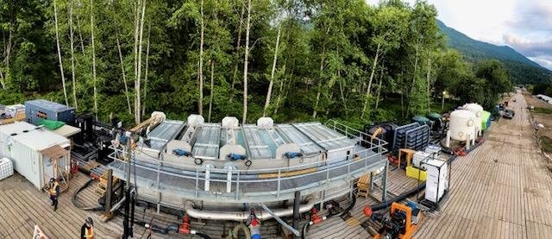
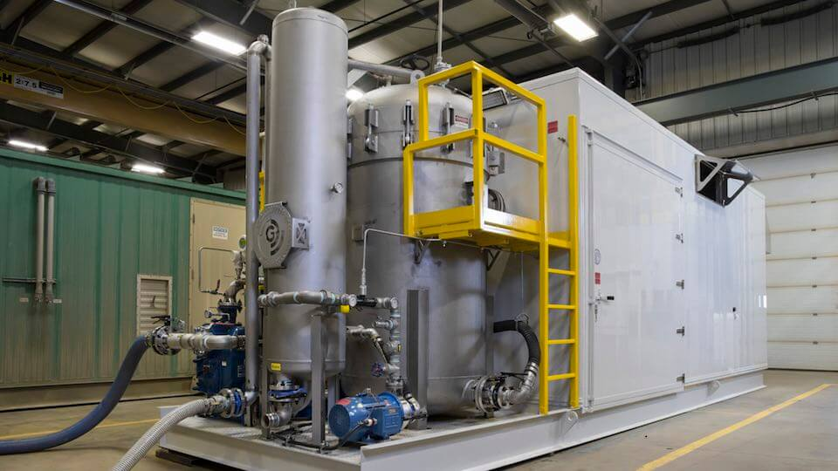
Ground Effects Environmental Services - company examples
Notes:
This second example is from Ground Effects Environmental Services and has a business relationship with Aqua Pure.
Their systems can be mobile and temporary, or built into permanent infrastructure and used in water hub systems.

Slide 21
More questions ?
… and thanks …
The Medicine River Watershed Society appreciates Alberta Government’s interest in the Paskapoo Aquifer and the Medicine River and all actions we can coordinate to protect our freshwater.
Through this freshwater, all 77,000 residents are connected to a vast area of our province and interwoven with the industries that can allow us to thrive for generations more.
Notes:
In partnership or with granting supports the MRWS can do state of the art data work with our current partners including municipalities, Red Deer River Alliance, and industry supporters. We can work with or provide Alberta Environment and Energy ministries clarity for best practices in municipal, energy sector, and agricultural use of freshwater and disposal.
All this work can contribute to a healthy aquifer and improved river.
We look for Alberta Government continued interest in the aquifer and watershed. Possible regulation changes to promote best practices, funding support or partnerships for data collection can all lead to proven balanced approaches to freshwater use and protection of the natural environment in our watershed and downstream into other parts of Alberta.
Thank you to our MLAs and Ministers of the Crown for spending valuable time to discuss the Paskapoo aquifer and Medicine River in our region.
END -
Next slide is another river image

Slide 22
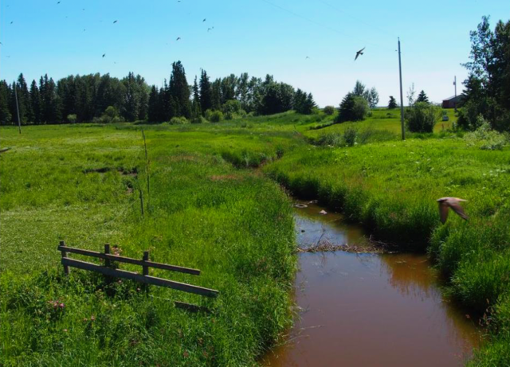
As long as the sun shines, the grass grows and the river flows

